Slide 1
Module-07: Part-2: Makefiles
CS 1714 – Computer Programming II

Slide 2
Make
Make is a project management tool used in Unix/Linux to automate compiling and linking. When we have a lot of source files to manage, make is great for organizing which files to compile and when. A Makefile contains a set of rules or commands that are needed to create the executable.
To understand how the make rules work towards building the executable, we have to take an in-depth look into the four stages of gcc.

Slide 3

Four Stages of Compilation
Preprocessor
Compilation
Assembly
Linking
Resolve all preprocessor directives (anything with a #)
Convert the code into machine dependent assembly code
Convert the assembly code to object code (binary format) for a specific processor
Combine object code in the correct order, bring in libraries, and creates the executable file
We will now take an in-depth look into the stages of gcc. We already know what happens with the pre-processor, so we will start at the compilation stage.

Slide 4
Example
Let’s explore each of these gcc stages with a simple program. Consider this Hello, world! program saved in main.c
Normally, we type gcc main.c and that will compile the code into object code, link, and create the executable. If our program has more than one source file, we also enter them into the gcc command.
#include <stdio.h>
int main(int argc, char* argv[])
{
printf("Hello world!\n");
return 0;
}

Slide 5
Compiling Separately
We usually combine all compilation stages for all source files into one single gcc command. However, we can separate the compilation stages and do that for each file. To compile one source file at a time without linking, add the -c option to gcc:
The -c option converts the source file to assembly and then the object file. This will result in a .o file (e.g., main.c would result in a main.o) for each source file.
If the source file needed functions from other source files, like functions from another .c file, placeholders are inserted. These dependencies are resolved later during linking.
gcc -c main.c
gcc -c otherfile.c

Slide 6
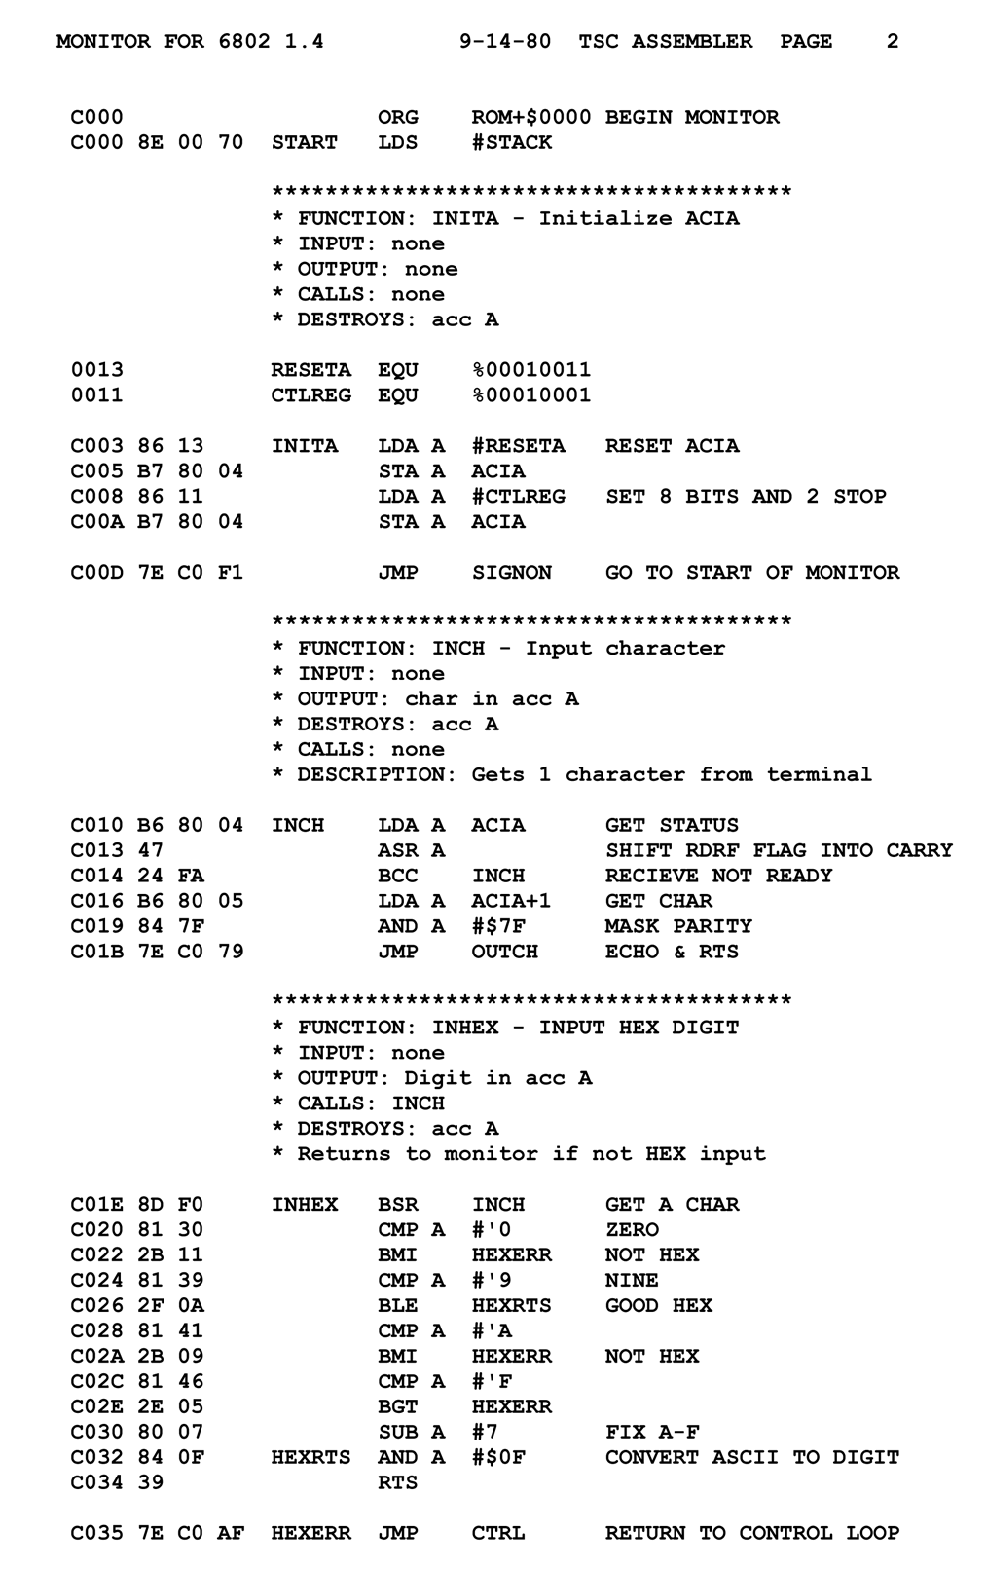
To Assembly
The gcc -c option will compile code into assembly and into object code. By default, we do not actually see the assembly code. We only see the object files (.o files).
We can instruct gcc to generate the assembly code file and stop the compilation process there. To generate the assembly code, we use the -S option with gcc.
gcc -S main.c will generate the main.s file which has the assembly code. The .s file is your C source code converted to machine dependent assembly code and it will look different for different processor architectures.

Slide 7
Example Assembly Code for Two Different Machines
x86_64-apple-darwin19
x86_64
_main: ## @main
.cfi_startproc
## %bb.0:
pushq %rbp
.cfi_def_cfa_offset 16
.cfi_offset %rbp, -16
movq %rsp, %rbp
.cfi_def_cfa_register %rbp
subq $32, %rsp
movl $0, -4(%rbp)
movl %edi, -8(%rbp)
movq %rsi, -16(%rbp)
leaq L_.str(%rip), %rdi
movb $0, %al
callq _printf
xorl %ecx, %ecx
.LC0:
.string "Hello world!"
.text
.globl main
.type main, @function
main:
.LFB0:
.cfi_startproc
pushq %rbp
.cfi_def_cfa_offset 16
.cfi_offset 6, -16
movq %rsp, %rbp
.cfi_def_cfa_register 6
movl $.LC0, %edi
call puts
movl $0, %eax
popq %rbp
33 lines total!
26 lines total!
Notes:
33 lines

Slide 8
More about Assembly
For the adventurous, you can embed inline assembly code into your C program using __asm__. This is one way in which C can also be a low-level language. You can use assembly for direct access to the machine’s hardware and optimizing code. There are common instruction elements across machines, but you need to know particular machine’s instructions set.
You will learn more about assembly code in future CS courses.
For the makefiles, we will not need to separate the compiler to assembly and assembly to object code stages.

Slide 9
To Object Code
After generating the assembly code, you can again use gcc to convert the assembly file (main.s) to the object file. In addition to using the -c option with the .s file, you will use the -o option:
Recall that the -o option for gcc designates an output file name. In this case, we will call it the same name of the file with the .o extension. This resulting file is the object code for the main source file. For programs with multiple source files, the last step would be linking all the object files together to create the executable.
gcc -c main.s -o main.o

Slide 10
Example of Object Code
Here are a few lines of the object code generated from the x86_64 (on CS Fox Linux Servers) example. The assembly code in the right columns is what you saw from our assembly code example.
0000000000000000 <main>:
0: 55 push %rbp
1: 48 89 e5 mov %rsp,%rbp
4: 48 83 ec 20 sub $0x20,%rsp
8: 64 48 8b 04 25 28 00 mov %fs:0x28,%rax
f: 00 00
11: 48 89 45 f8 mov %rax,-0x8(%rbp)
15: 31 c0 xor %eax,%eax
17: c7 45 f0 54 65 78 61 movl $0x61786554,-0x10(%rbp)
1e: 66 c7 45 f4 73 00 movw $0x73,-0xc(%rbp)
24: 48 8d 45 f0 lea -0x10(%rbp),%rax
28: 48 89 c7 mov %rax,%rdi
2b: e8 00 00 00 00 callq 30 <main+0x30>
30: 89 45 ec mov %eax,-0x14(%rbp)

Slide 11
Linking
The final stage of gcc is linking, which is when gcc will combine all the object code files in the correct order, bring in the object code from libraries to replace any placeholders in our code, and then create the executable.
Assume that you have multiple object files: main.o and myfunctions.o
Use gcc and list all the object files you have. Then, use the -o to designate the executable name. If you do not use the -o option, it will create the default a.out.
gcc main.o functions.o –o myprogram

Slide 12
Multiple Source Files
Assume that you have multiple source files: main.c and myfunctions.c and are building the executable named myprogram. The approach we have been using to compile all source files in the same gcc statement is:
Now, the approach to compile multiple source files separately and then link them separately involve these multiple gcc statements:
gcc main.c myfunctions.c -o myprogram
gcc –c main.c
gcc –c myfunctions.c
gcc main.o myfunctions.o –o myprogram

Slide 13
Compiling and Linking
Separating compiling from linking can save time by only focusing on re-compiling changed files. Imagine if you had many files and/or it took a long time to compile each file.
Because projects can have multiple files (imagine hundreds), finding the files to recompile might be difficult. Also, our final linking gcc command might get too tedious to type. We can use makefiles to help us automate this process.
gcc –c main.c
gcc –c myfunctions.c
gcc main.o myfunctions.o –o myprogram

Slide 14
Makefiles
We can create a simple makefile to help organize, compile, and link multiple source files together. This file is saved as makefile. You can use vim to create this file.
A makefile consists of several make rules. A make rule has a target, list of prerequisites separated by a space, and a list of commands on separate lines (make recipe).
target: prerequisite1 prerequisite2
Command 1
Command 2

Slide 15
Makefiles
Each target should be the object file we are trying to build. Include a target for each source file. clean is a special target used for deleting object files and executable files.
Each prerequisite is a dependency that is needed to build the object file (all the header and source files). If a dependency is modified, make will rebuild this target.
The make recipe are the commands that are needed to build that target. Think of what command(s) you would enter on the command line.

Slide 16
Sample makefile
You need a make rule for each object file as determined by each source file. List out all the prerequisites this source file has.
myprogram: main.o myfunctions.o
gcc main.o myfunctions.o -o myprogram
main.o: main.c myfunctions.h
gcc -c main.c -o main.o
myfunctions.o: myfunctions.c myfunctions.h
gcc -c myfunctions.c -o myfunctions.o
clean:
rm -rf *.o
rm myprogram
You do not actually need to use the -o option in the individual gcc commands for the individual source files. They were included to make explicitly sure what the object file names will be.
clean commands will remove any files generated by this Makefile program (.o files and the executable).
Make recipes require a tab. Regular vim tabs do NOT work! To force a tab in vim, be in Insert Mode, hit CTRL+V, and then tab.
This makefile is for a program that has three files:
main.c
myfunctions.c
myfunctions.h

Slide 17
Using the Makefile
To execute the Makefile, type make at the command line. This will step through all the make rules that apply. It will only run the commands for files that changed and their dependent files.
Our Makefile creates an executable, named myprogram. Depending on your Linux machine, we may no longer need to add ./ in front of the executable name to execute it!
To clean up the Makefile's files, type make clean at the command line

Slide 18

Makefiles
There are several advantages to makefiles:
Makefiles automate the compiling and linking process (without having to retype the entire gcc statement). There is less repetition, and less room for errors, for retyping the gcc statement
It saves time because it only recompiles changed files. The makefile shows you what the exact steps in building the executable are and what the dependencies are between your files.
Makefiles are great for managing large projects. If you are distributing your large project, remember that the executables are machine dependent. So, the user has to compile your project on their machine. Providing a makefile allows them to easily build the executable since they only have to type make.
We will be using makefiles with our programming projects.

